Slide 1
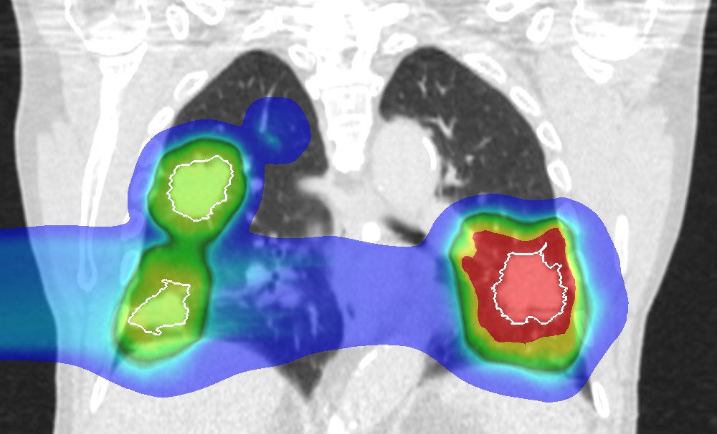
In Silico Comparison of Photons versus Carbon Ions in Single Fraction Therapy of Lung Cancer
Kristjan Anderle

Slide 2
Outline
Introduction
Lung Cancer Patients – Cohort 1
Lung Cancer Patients – Cohort 2
Conclusion & Outlook

Slide 3
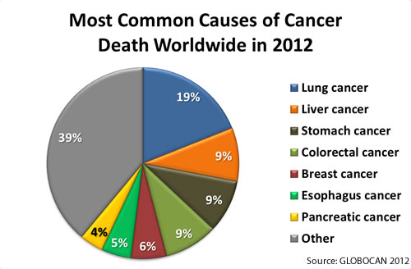
Introduction

Slide 4
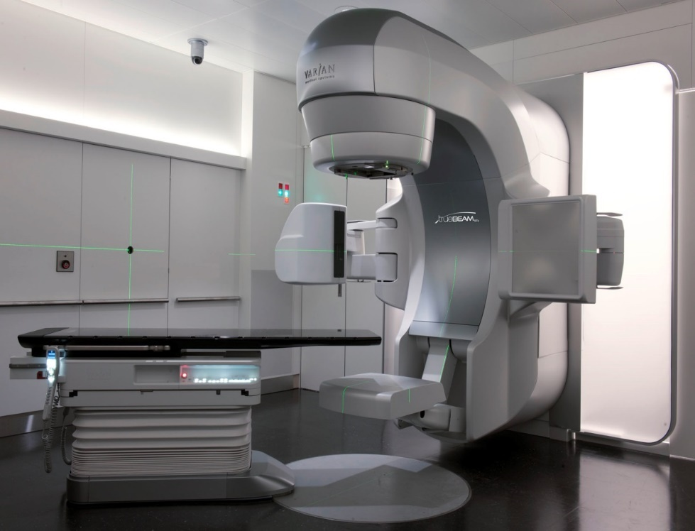

Stereotactic Body Radiation Treatment (SBRT)
High precision treatment with photons
Delivers high dose (up to 30 Gy) in few fractions (1-3)
Good results for lung cancer in early stages
Limited for:
Multiple tumors
Large tumors

Slide 5
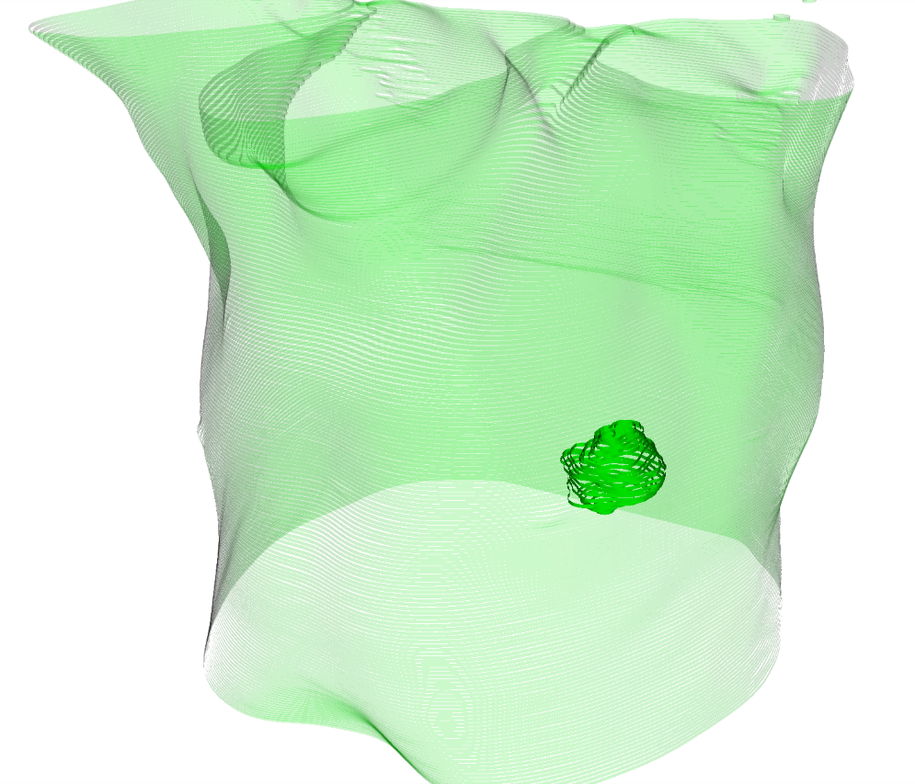

3D Treatment Plan Example
Notes:
Why do you show this?

Slide 6
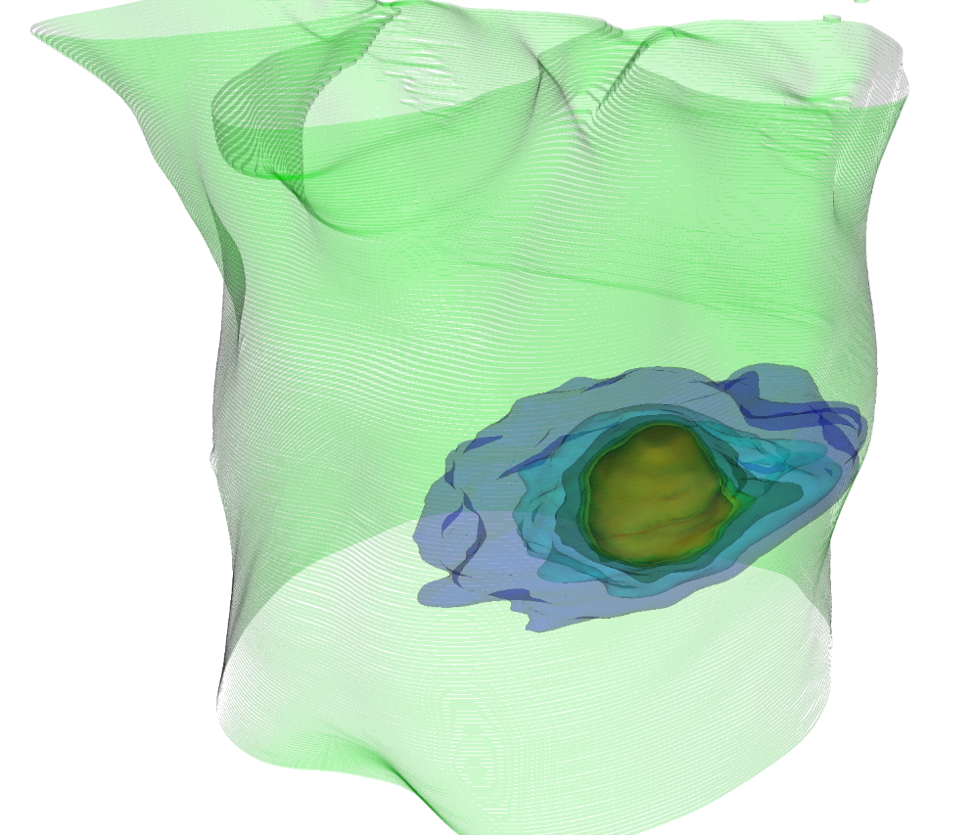
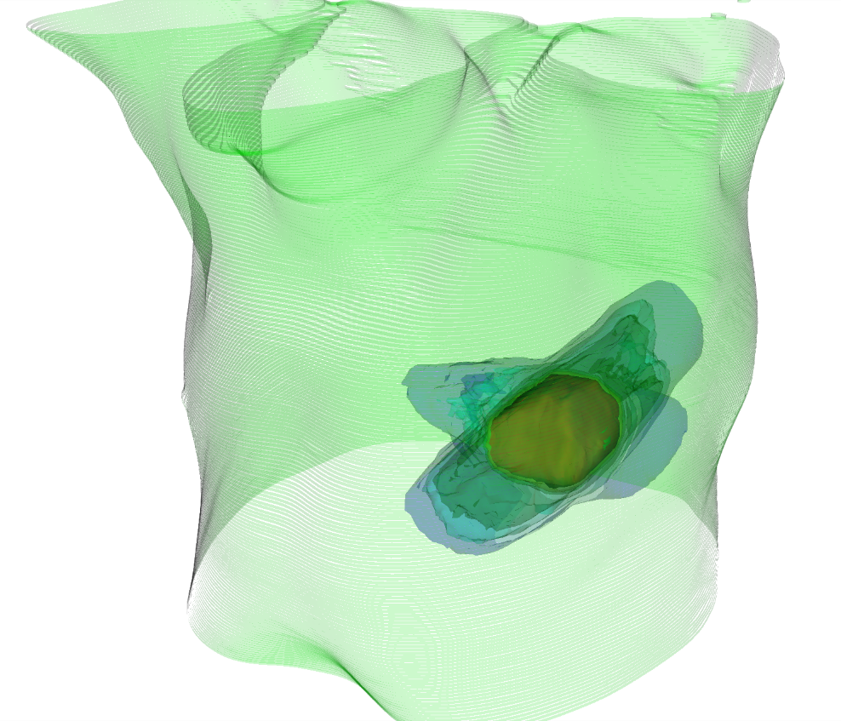
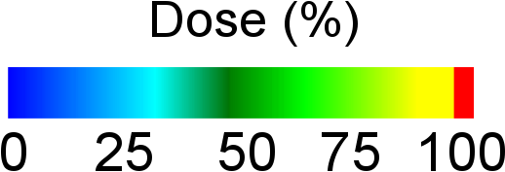
3D Treatment Plan Example
SBRT
¹²C

Slide 7
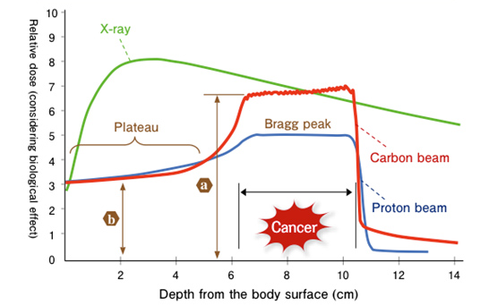
Particle Therapy
Advantageous dose profile for radiotherapy
Bragg peak depends on particle energy
No or small dose tail after the Bragg peak
Currently, mostly static targets are treated (head & neck, prostate)
Source:NIRS,2016
Notes:
Povad ta slide.

Slide 8
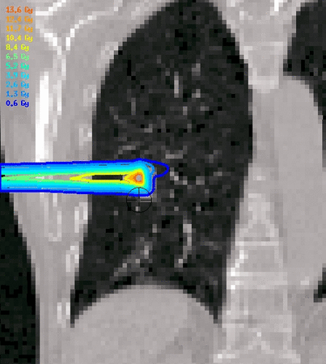
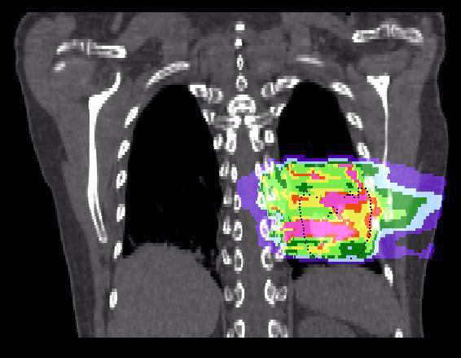
Motion Effects in Particle Therapy
Courtesy M. Söhn, LMU
Courtesy C. Graeff, GSI

Slide 9
In Silico Study
Comparison of lung cancer treatment simulations between SBRT and active scanning carbon-ions (PT)
23 lung cancer patients were actually treated with SBRT
Comparison:
Dose to the tumor
Dose to critical organs
Dose escalation

Slide 10
Outline
Introduction
Lung Cancer Patients – Cohort 1
Lung Cancer Patients – Cohort 2
Conclusion & Outlook

Slide 11
Patient Data
19 patients
26 tumors
Each tumor 1 x 24 Gy
Average tumor volume: 2.9 (range, 0.4 – 139) cm³
Average tumor motion amplitude: 3.1 (range, 0.1 – 12) mm

Slide 12
PT Treatment planning
Single field uniform optimization
10 dose calculations per patient:
Without motion, static (2x)
With motion, without compensation, 4D-interplay (4x)
With motion, with compensation, 4D-rescanning (4x)

Slide 13
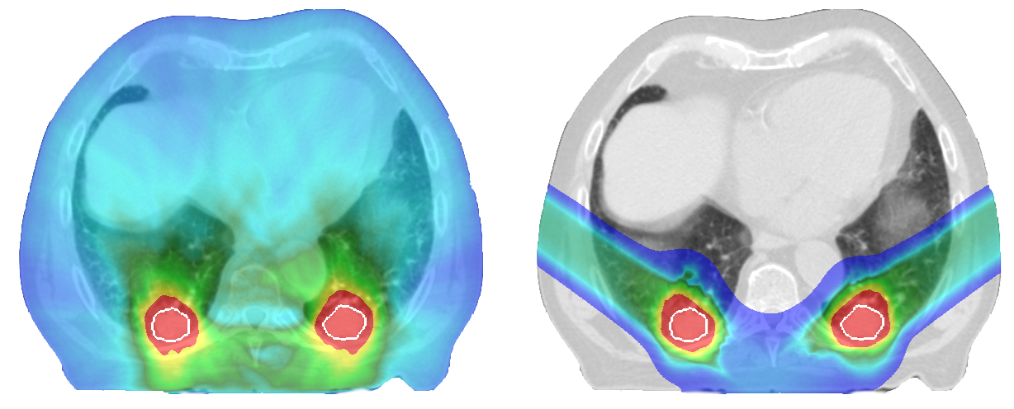
Treatment Plan Examples
SBRT
PT
Notes:
Uvod v to.

Slide 14
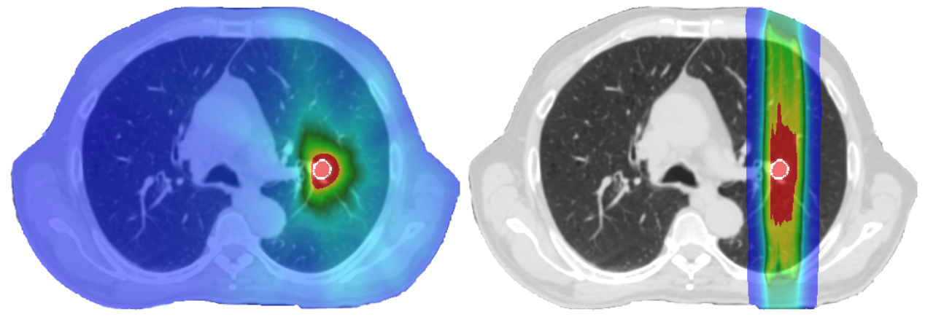
Treatment Plan Examples
SBRT
PT

Slide 15
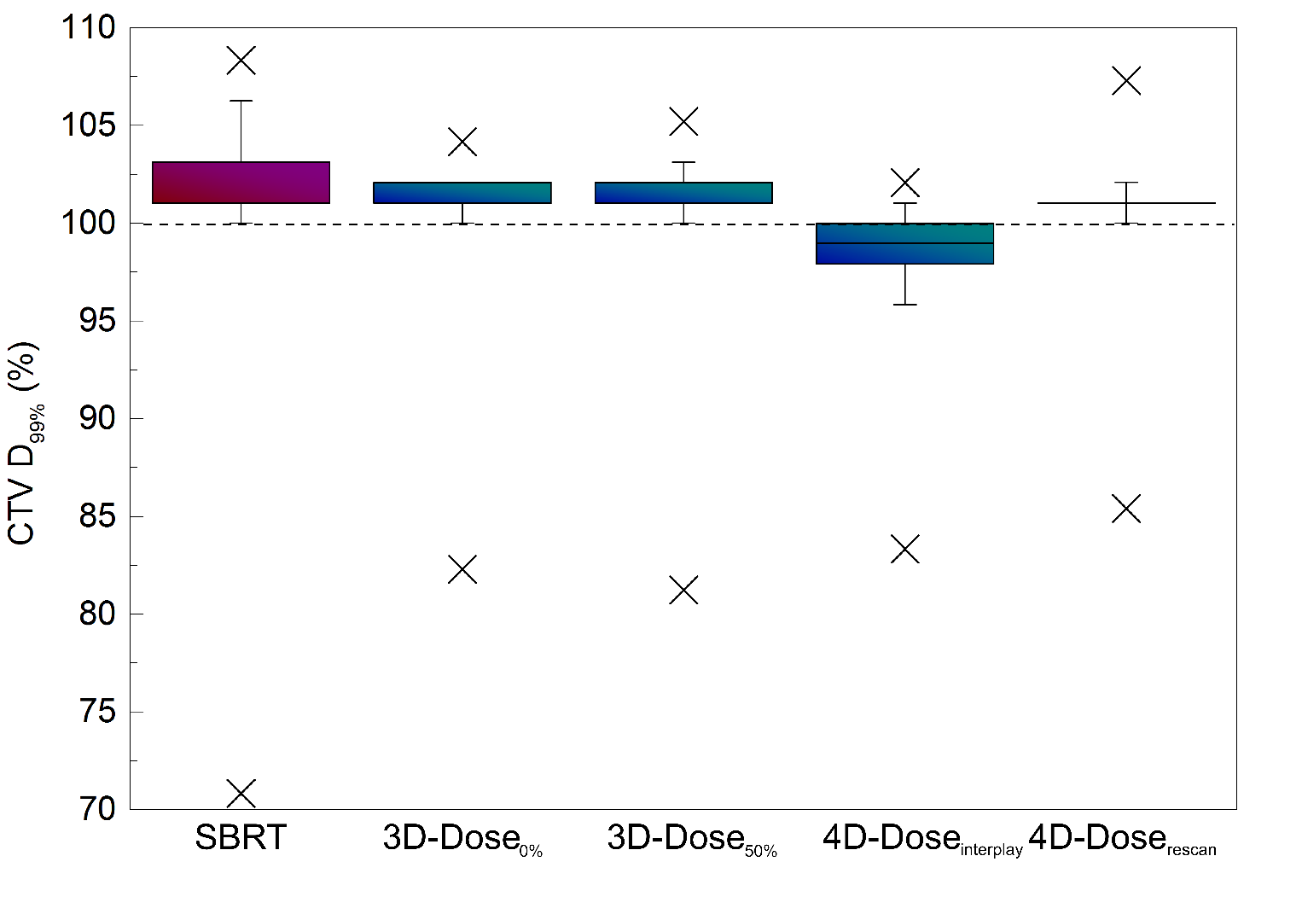
Results – Dose to Tumors
No difference in tumor dose between SBRT and static PT (3D)

Slide 16
Results – Dose to Tumors
No difference in tumor dose between SBRT and static PT (3D)
Without motion compensation the tumor dose is too low (4D interplay)

Slide 17
Results – Dose to Tumors
No difference in tumor dose between SBRT and static PT (3D)
Without motion compensation the tumor dose is too low (4D interplay)
Rescanning mitigates tumor motion sufficiently (4D rescan)

Slide 18
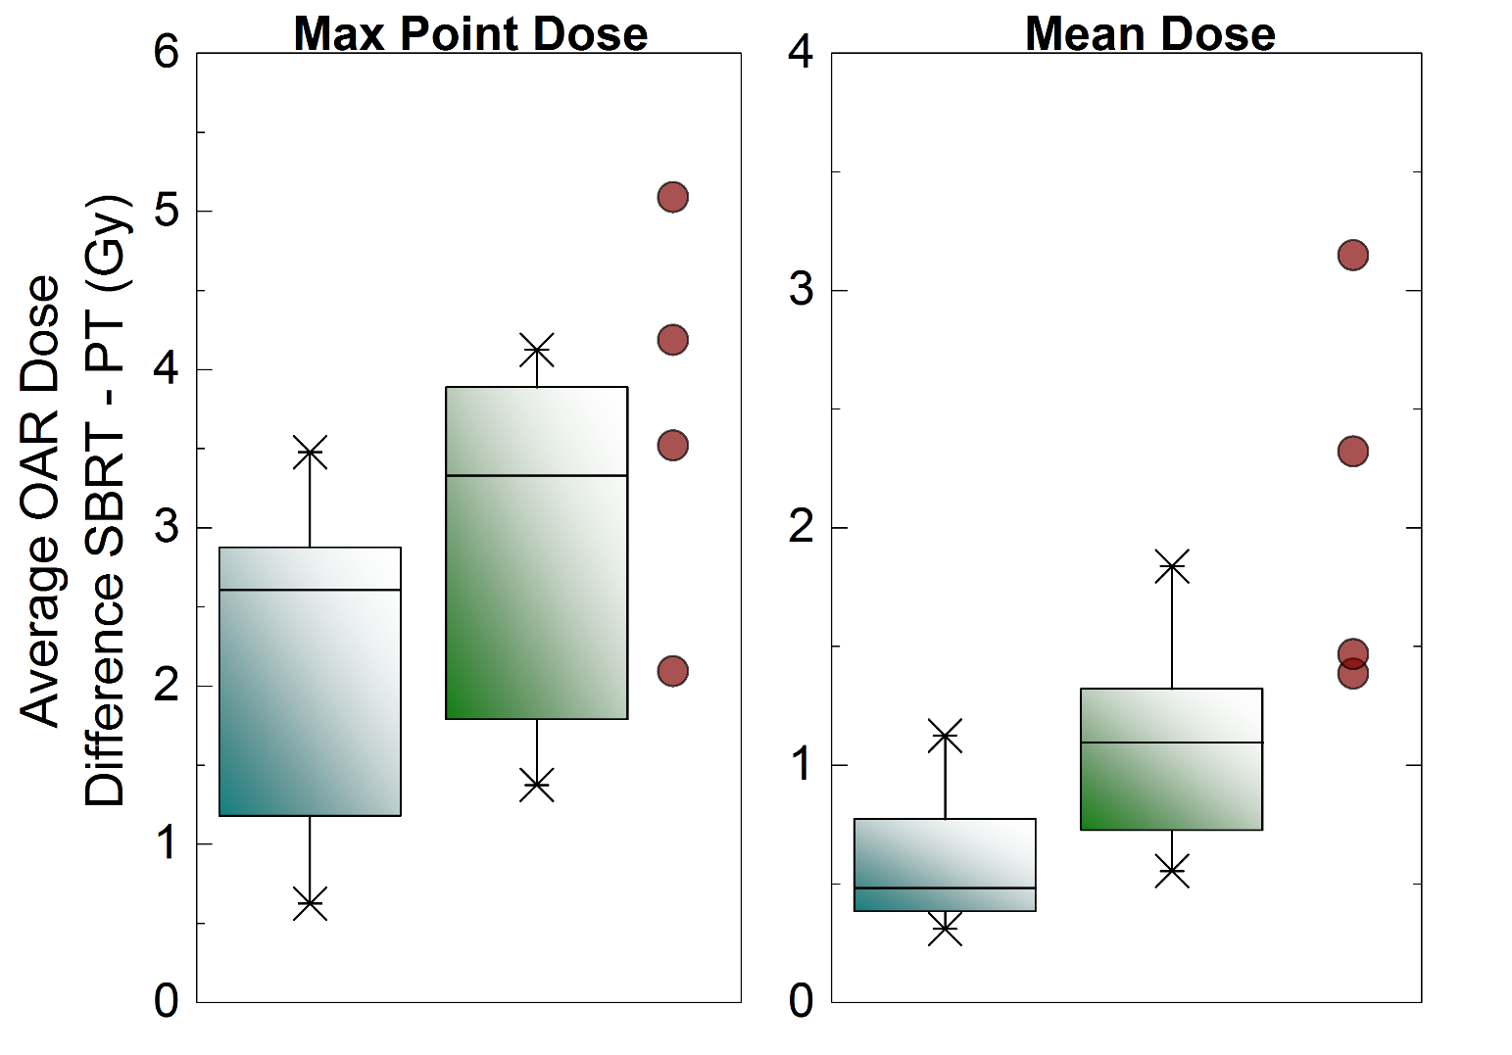
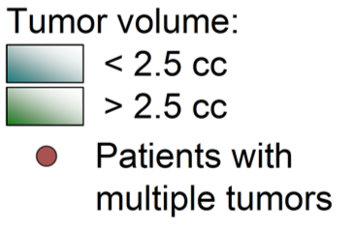
Results - Dose to Critical Organs
Notes:
CiT v PT

Slide 19
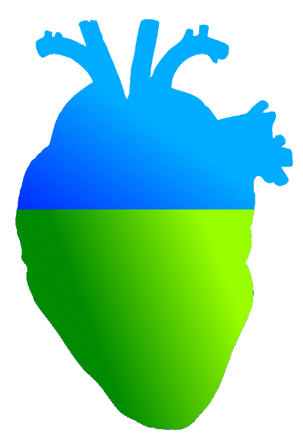
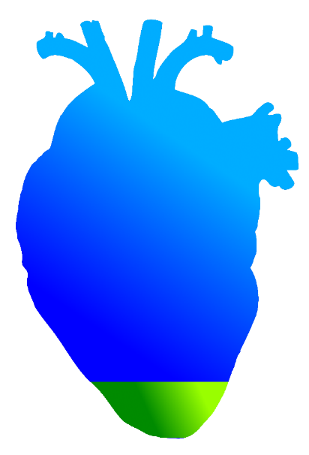
Dose to the Heart
Higher heart (V5) dose was directly correlated to higher mortality (Bradley, JD et al, Lancet Oncology, 2015)
SBRT
PT
55%
Volume reciving 5% (1.2 Gy) dose
7.6%
Notes:
Ne pozabit na ta slajd.

Slide 20
Outline
Introduction
Lung Cancer Patients – Cohort 1
Lung Cancer Patients – Cohort 2
Conclusion & Outlook

Slide 21
Patient Data
8 patients
24 tumors
3 tumors in 2 patients received 3 x 9 Gy
1 tumor received 5 x 7 Gy
All others 1 x 24 Gy
Average tumor volume: 4.1 (range, 0.4 – 139) cm³
Average tumor motion amplitude: 5.9 (range, 0.5 – 17) mm
Several critical organs in close vicinity to the tumor

Slide 22
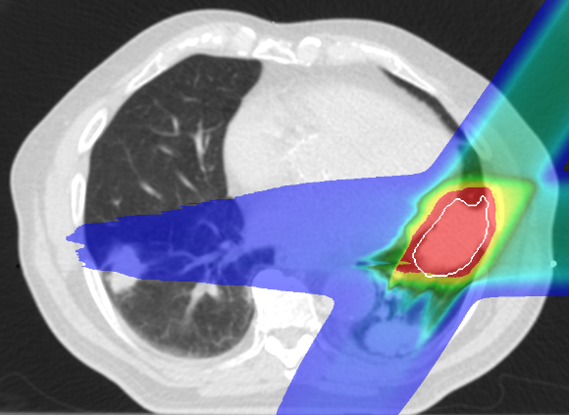
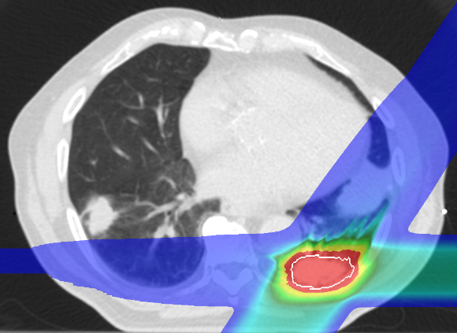
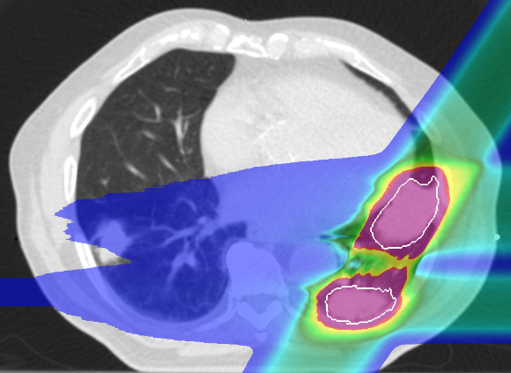
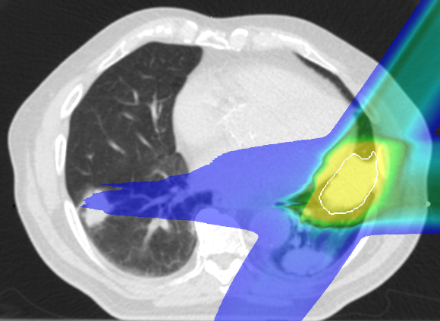
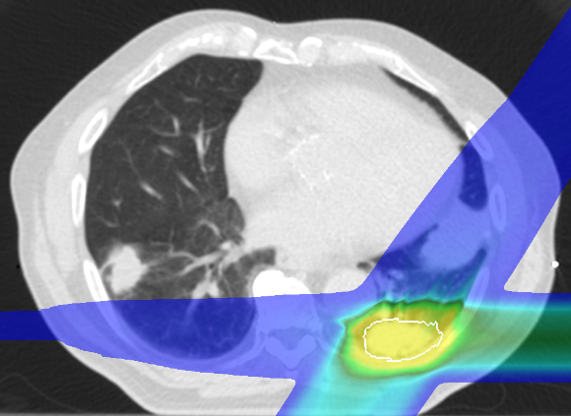
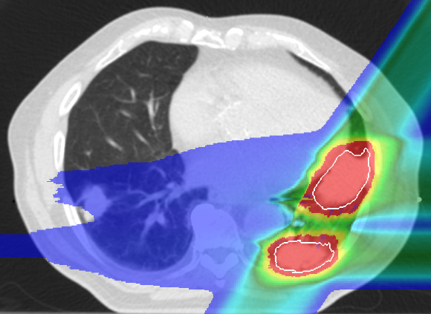
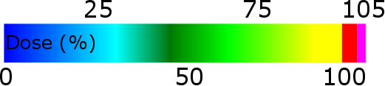
Intensity Modulated Particle Therapy Optimization for Multiple Targets
Target 1
Target 2
Target 1 & 2
SFUD
IMPT (new)

Slide 23
PT Treatment planning
Intensity modulated particle therapy optimization
8 dose calculations per patient:
2 optimizations
All with motion and rescanning
4 breathing patterns
Dose escalation for 3 patients to 1 x 24Gy

Slide 24
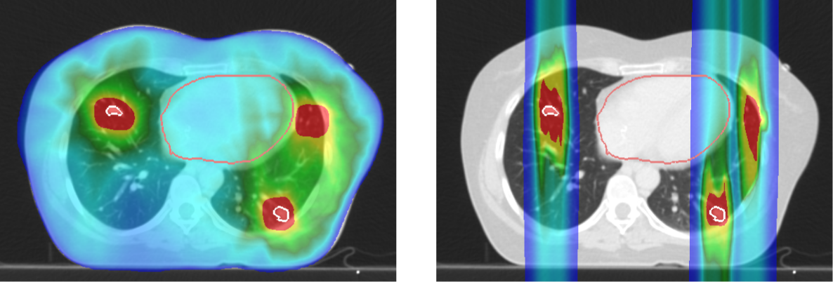
Treatment Plan Examples
SBRT
PT
All 5 targets recived planned dose with SBRT and PT (CTV D_{99%} > 100 %)
Notes:
Uvod?

Slide 25
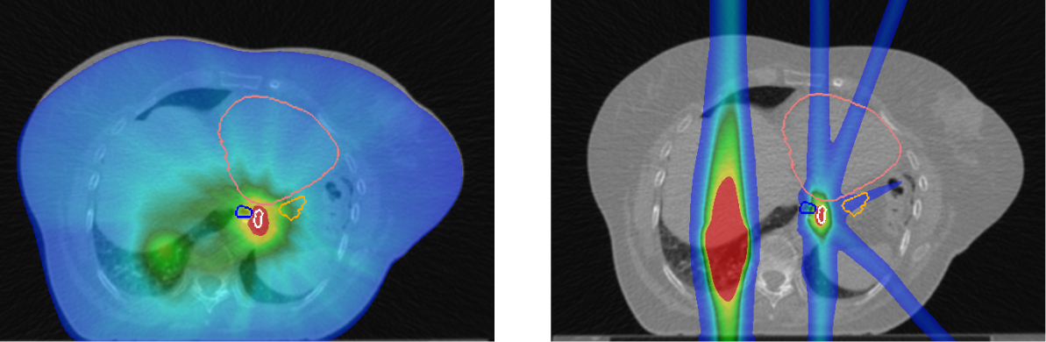
Treatment Plan Examples
Heart
Heart
Esophagus
Stomach
Esophagus
Stomach
Target
Target
SBRT
PT
Planning dose not met wiht PT
(SBRT D_{99%} = 100%, PT D_{99%} = 75%, )

Slide 26
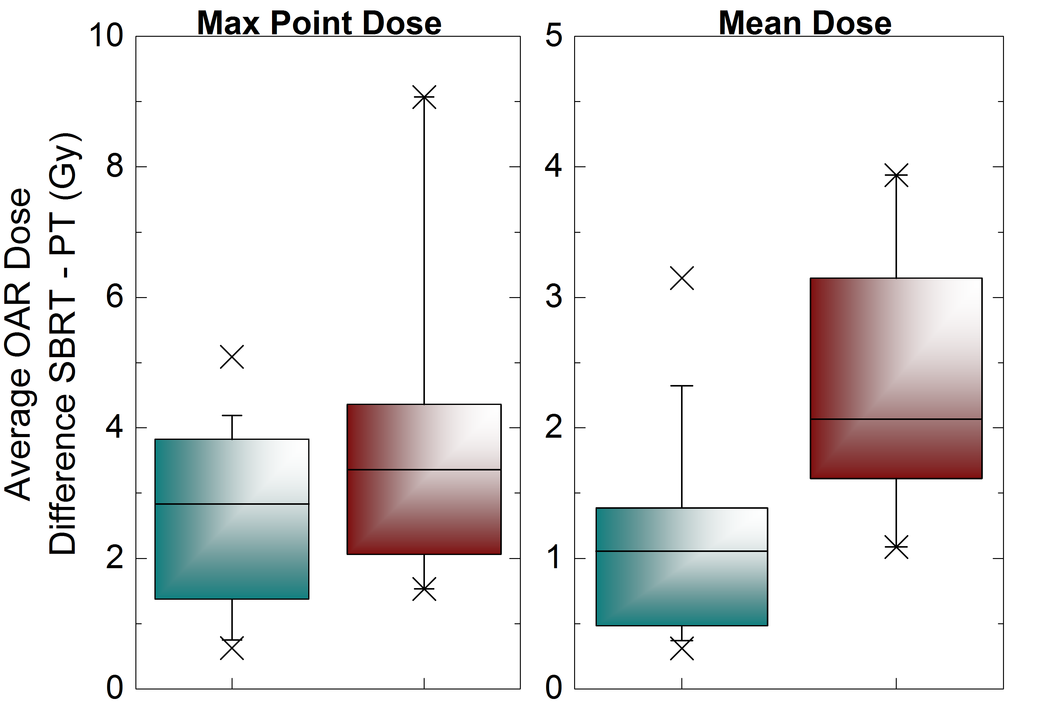
Results – Dose to Critical Organs
Cohort I
Cohort II
Cohort I
Cohort II

Slide 27


Average Heart V5
SBRT
PT
81 %
8.7%
Notes:
Ne pozabt

Slide 28
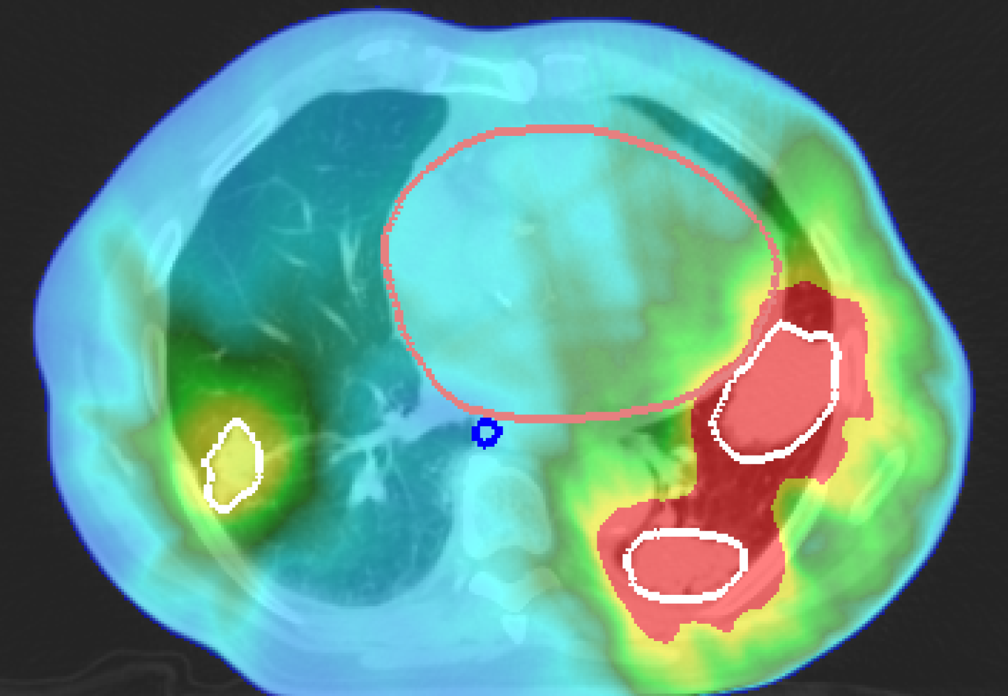
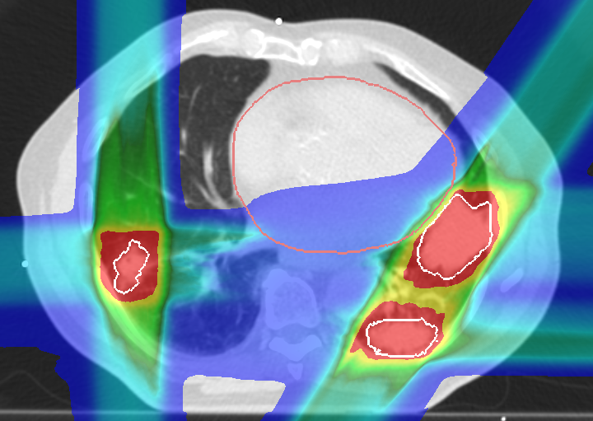
Results – Dose Escalation
1 tumor: 1 x 22 Gy
2 tumors: 1 x 21 Gy
2 tumors: 3 x 9 Gy
5 tumors: 1 x 24 Gy

Slide 29
Heart Dose Volume Histogram

Slide 30
Outline
Introduction
Lung Cancer Patients – Cohort 1
Lung Cancer Patients – Cohort 2
Conclusion & Outlook

Slide 31
Conclusions
PT delivers the same dose to tumors as SBRT,
while depositing significantly less dose to normal tissue
Patients with large or multiple tumors would especially benefit from PT
PT could deliver full ablative dose in single fraction, where SBRT could not

Slide 32

Outlook
First lung cancer patients treated with active scanning carbon-ions at NIRS, Chiba (Japan)
Results from this study (especially multi target case) will be used for actual treatment as part of LOEWE
Notes:
Zvad loewe

Slide 33

Acknowledgments
GSI
C. Graeff
M. Durante
A. Eichhorn
M. Prall
S. Hild
FC
J. Stroom
C. Greco
N. Pimentel
S. Vierra
UK Erlangen
C. Bert
T. Brandt
J. Wölfelschneider

